Slide 1
Proctoring Suggested Changes

Slide 2
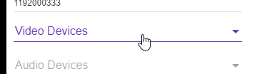
Video Devices
Issue/Fix
Screenshot
If the user disallows the Chrome plugin access, then the program will go on as normal.
If user disallows microphone and video access, then disallow them to continue. Kindly remind them how to re-enable access.
Notes:
Critical issue, as I am not quite sure how to re-enable it.

Slide 3
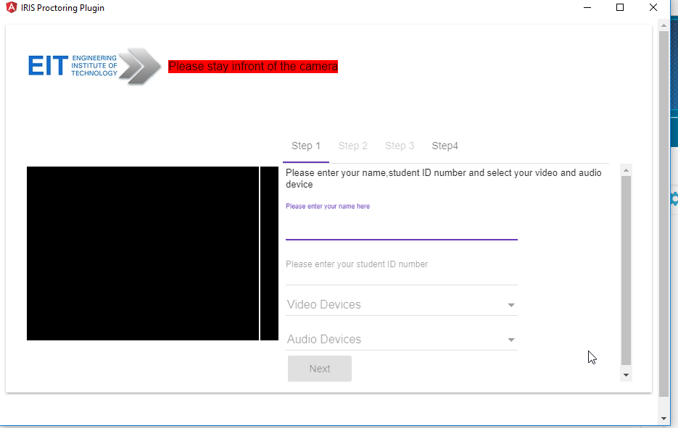
Overflow Issue
Issue/Fix
Screenshot
Too many scroll bars.
Can be fixed by hiding the overflow.
Alternatively resizing the popup window could be disabled.
Notes:
.mat-tab-body-content {
overflow: hidden;
}

Slide 4

Favicon
Issue/Fix
Screenshot
The Angular Favicon needs to be replaced.

Slide 5
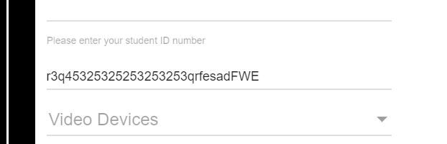
Student ID Validation
Issue/Fix
Screenshot
Students may accidentally enter there student IDs incorrectly.
Add a cap on the amount of characters allowed for Student ID / check if the ID is correct.

Slide 6
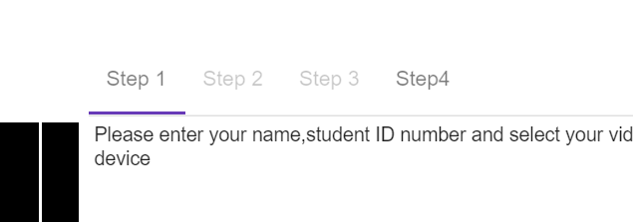
Video Devices
Issue/Fix
Screenshot
Step4 is enabled, and has no spacing between the word ‘Step’ and ‘4’.
Gray out ‘Step4’, and add space between ‘Step’ and ‘4’.

